Slide 1

FEASIBILITY ANALYSIS AND PERFORMANCE TESTING OF COLLISION DETECTION ALGORITHMS FOR SATELLITES
Capstone Project Phase B
23-2-D-17
Hallel Weil
Omer Shamir
Supervisor: Mr. Ilya Zeldner

Slide 2

Introduction
Active\Old Satellites, Space debris
Satellites
Space debris
Finding possible collisions
Active satellites[orange]
Inactive satellites[Blue]
Space debris[Grey]
Rocket bodies[purple]
Uncategorized[pink]
Notes:
הצגה קצרה של הרקע: הבעיה, הצורך לפיתוח המערכת
הבעיה

Slide 3
Introduction
Direct calculations are computationally expensive
Faster algorithms need to be tested
Implementing on a satellite on-board computer
Testing the algorithms
Notes:
הצגה קצרה של הרקע: הבעיה, הצורך לפיתוח המערכת
הצורך בפיתוח

Slide 4
Algorithms
Approximations using polynomials
ANCAS
SBO ANCAS
CATCH
Notes:
הצגה קצרה של הרקע: הבעיה, הצורך לפיתוח המערכת
הבעיה - האלגוריתמים

Slide 5
Expected result
Implemented, tested and ready to use algorithms
Testing system
Experiments result, feasibility of using the algorithms on satellites
Notes:
הדרישות המרכזיות של הפתרון

Slide 6
Solution
Implementing the algorithms
Running on the satellite dedicated computer
Comparing algorithms performance
Notes:
תיאור הפתרון

Slide 7

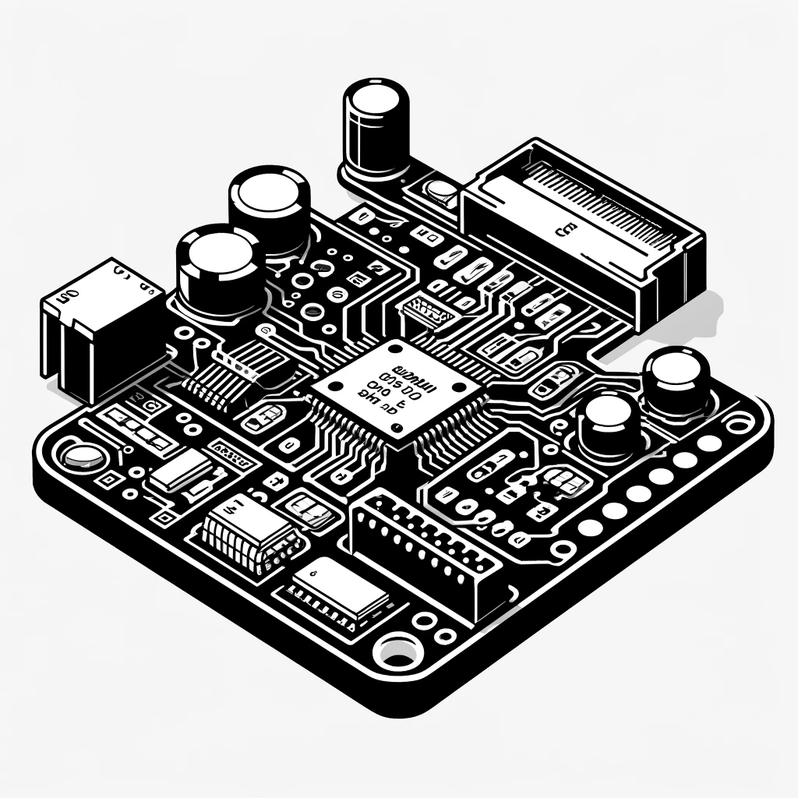
Testing System
2 parts testing system
Testing station
Tested on-board computer
User Interface
Test Creation and Management
Results Management
Database
Running tests
Running the algorithms
Testing runtime
Notes:
תיאור הפתרון

Slide 8
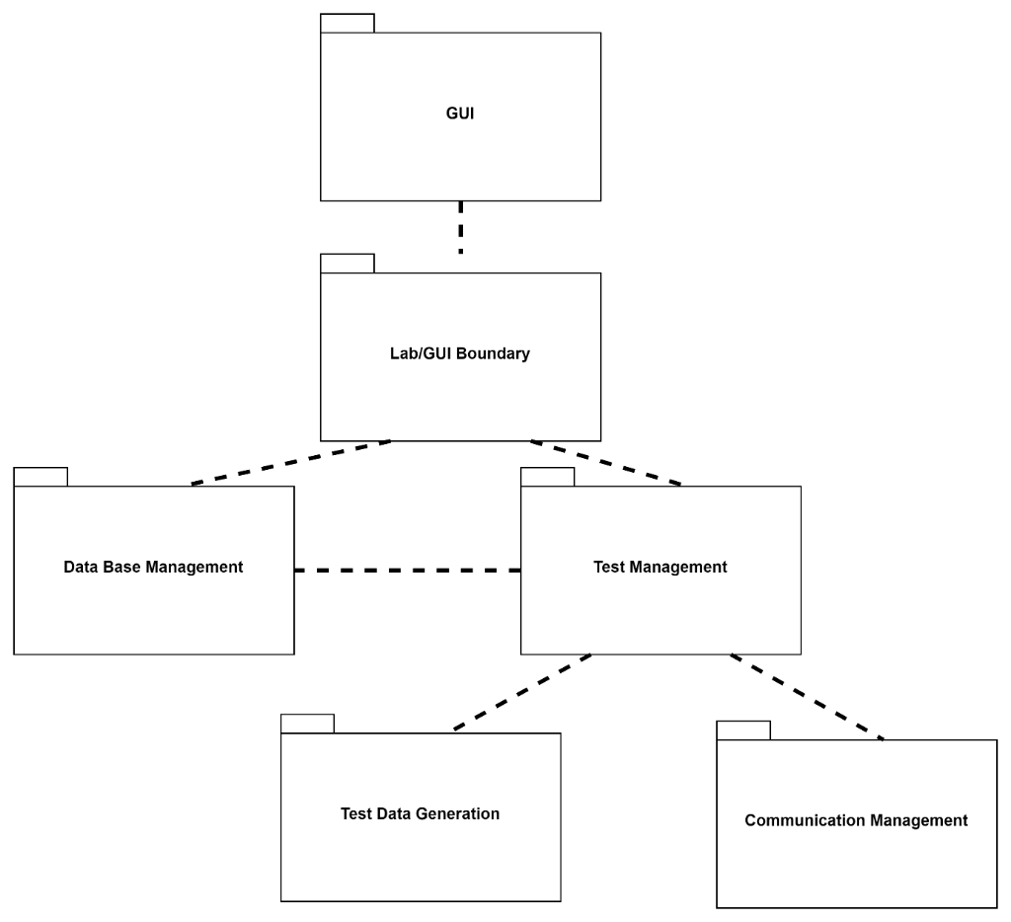
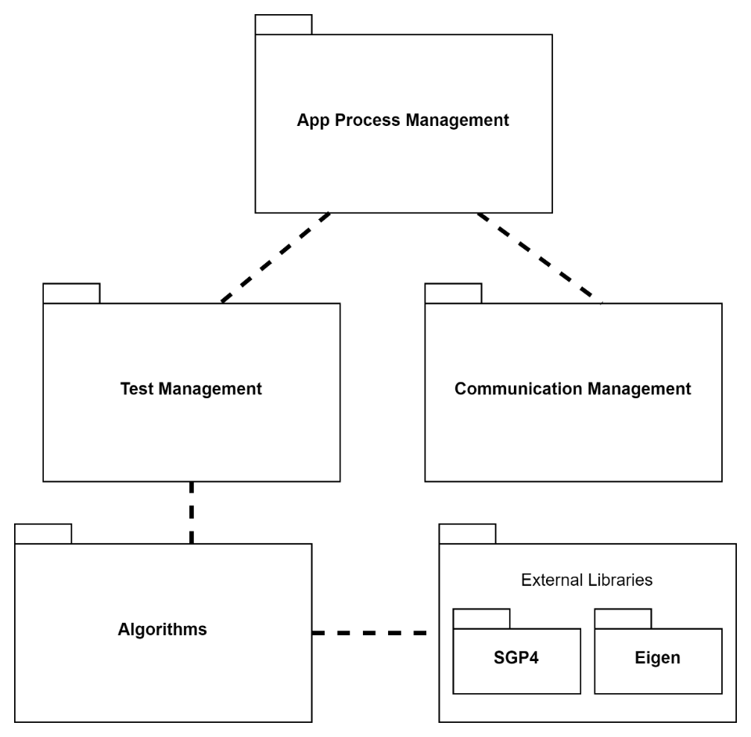
Testing System
Testing station
Tested on-board computer
Notes:
Package diagrams

Slide 9
Testing System - Communication
Defining a communication protocol
Error detection
Work on:
UDP
TCP
Local simulation
Notes:
Package diagrams

Slide 10
Testing System - Environments
Windows / WSL
TCP/UDP over Local host
Local simulation
Notes:
Package diagrams

Slide 11
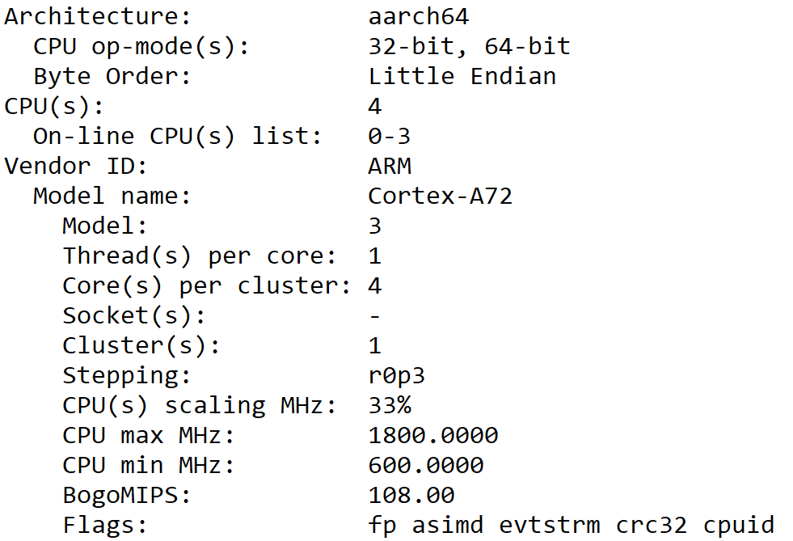
Testing System - Environments
Linux on Raspberry Pi 4
TCP/UDP
Testing Cross – Platform Communication
Notes:
Package diagrams

Slide 12
Testing System - Environments
gem5 simulation
Community led project
Framework for computer simulations
Accurate timing
Notes:
Package diagrams

Slide 13
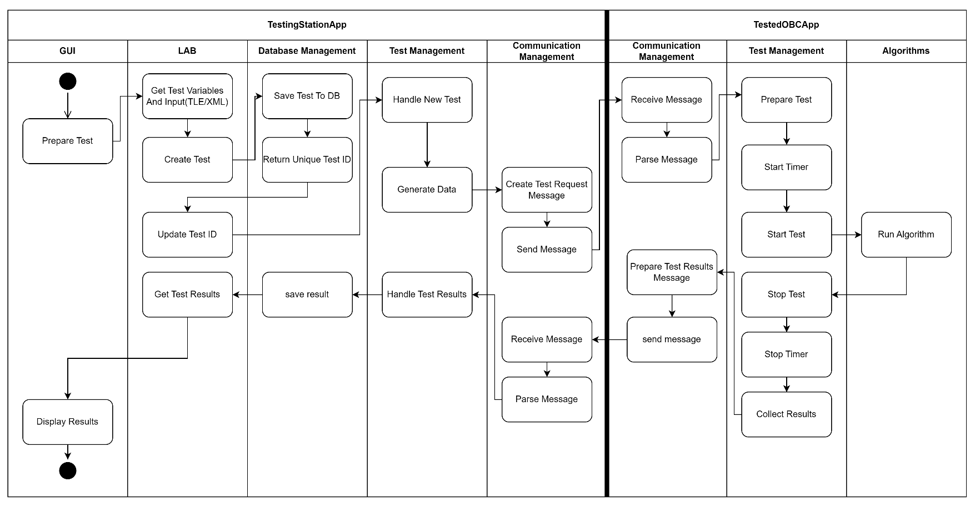
Testing System – Activity Diagram
Notes:
Activity diagrams

Slide 14
Feasibility Testing Environments
gem5 simulator with WSL
Simulation script - se
 | OBC[ ] | gem5 simulation script
CPU | 32-bit ARM9 | SimpleTimingCPU
CPU Frequency | 400MHz | 400MHz
Cache | 32-KB Data, 32-KB Instruction | 32-KB Data, 32-KB Instruction
Memory | 32MB SDRAM | SimpleMemory
Notes:
תיאור הפתרון

Slide 15
Feasibility testing - data
Catalog of objects from Celestrak
Used around 20% - ~5700 tests
3 days to run
Notes:
תיאור הפתרון

Slide 16
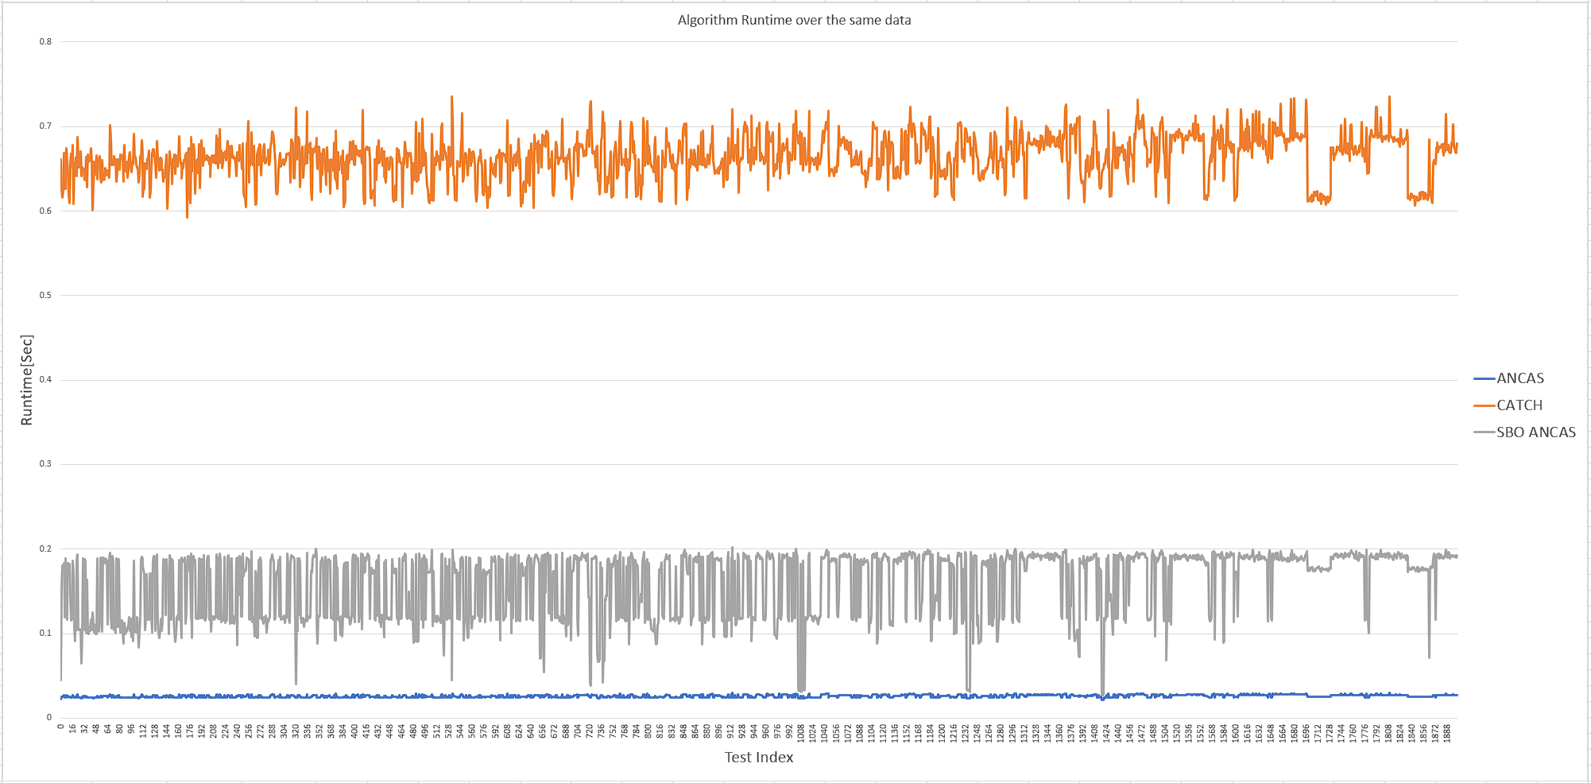
Feasibility testing - runtime
Notes:
תיאור הפתרון

Slide 17
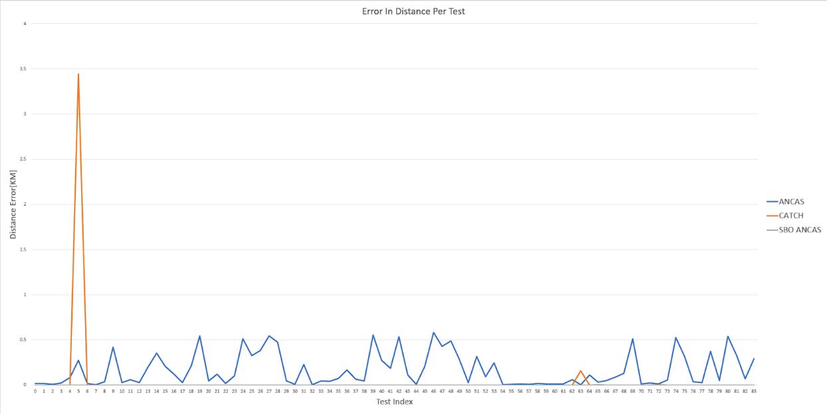
Feasibility testing - errors
Notes:
תיאור הפתרון
להוסיף?

Slide 18
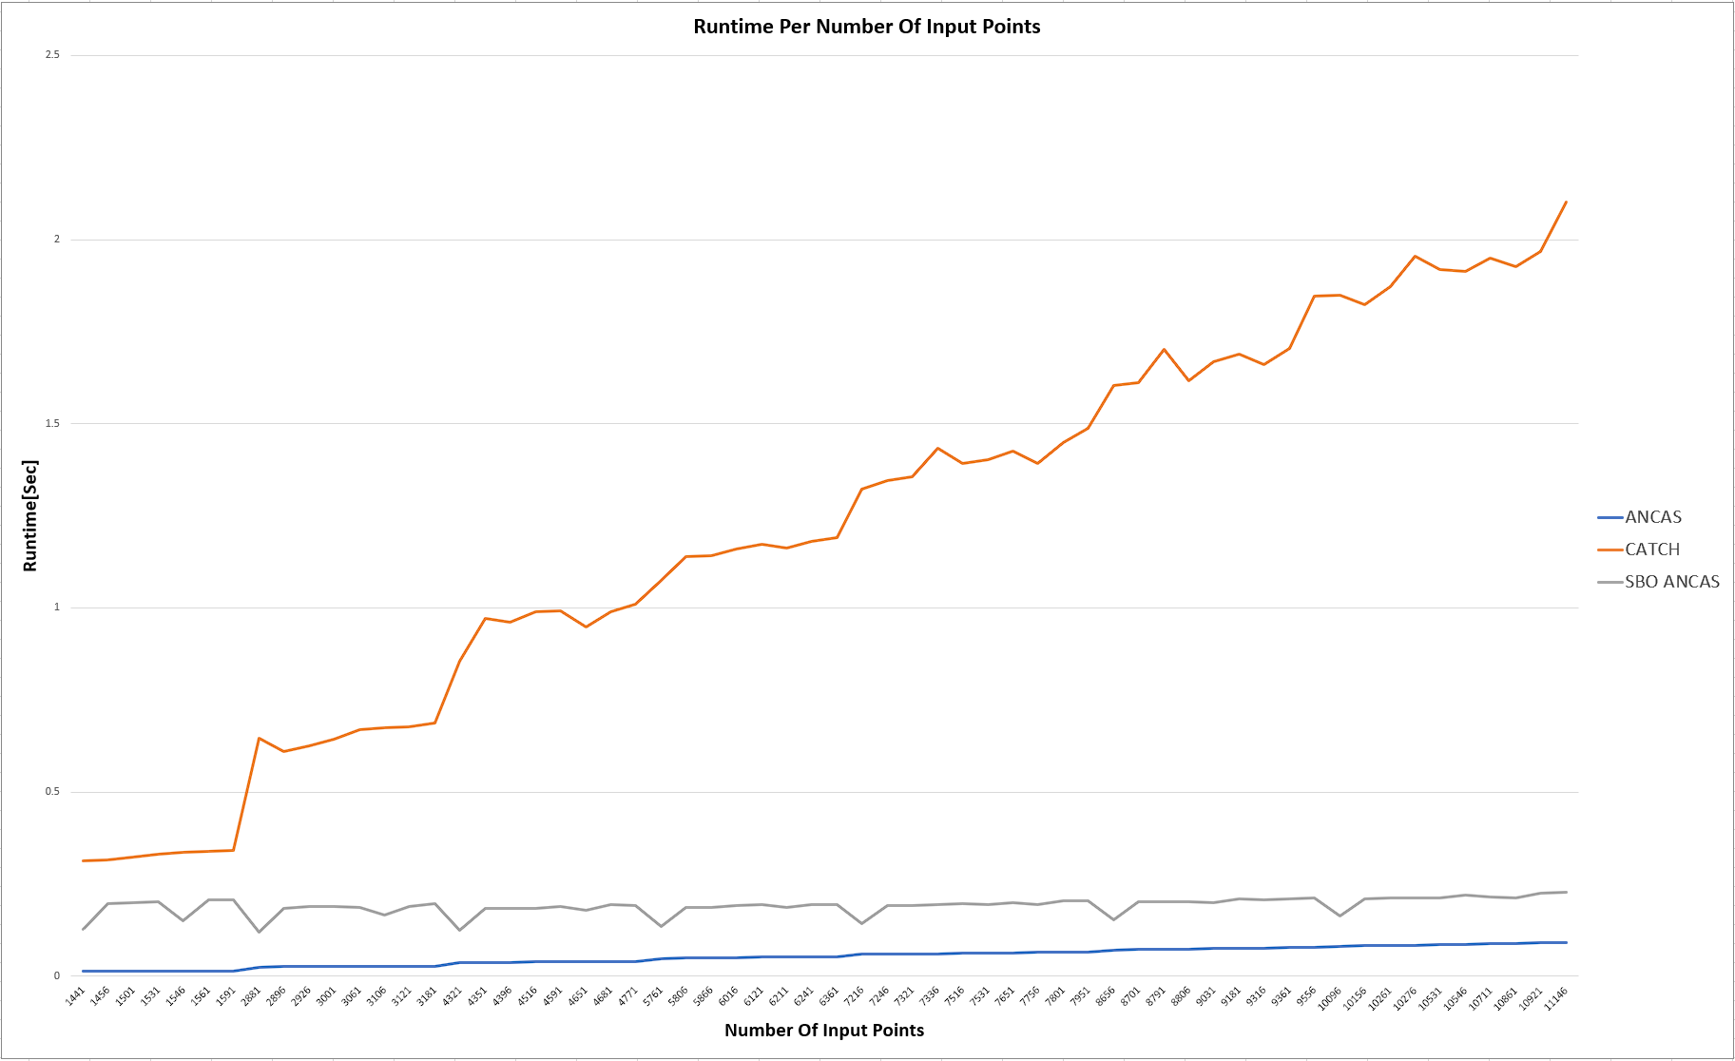
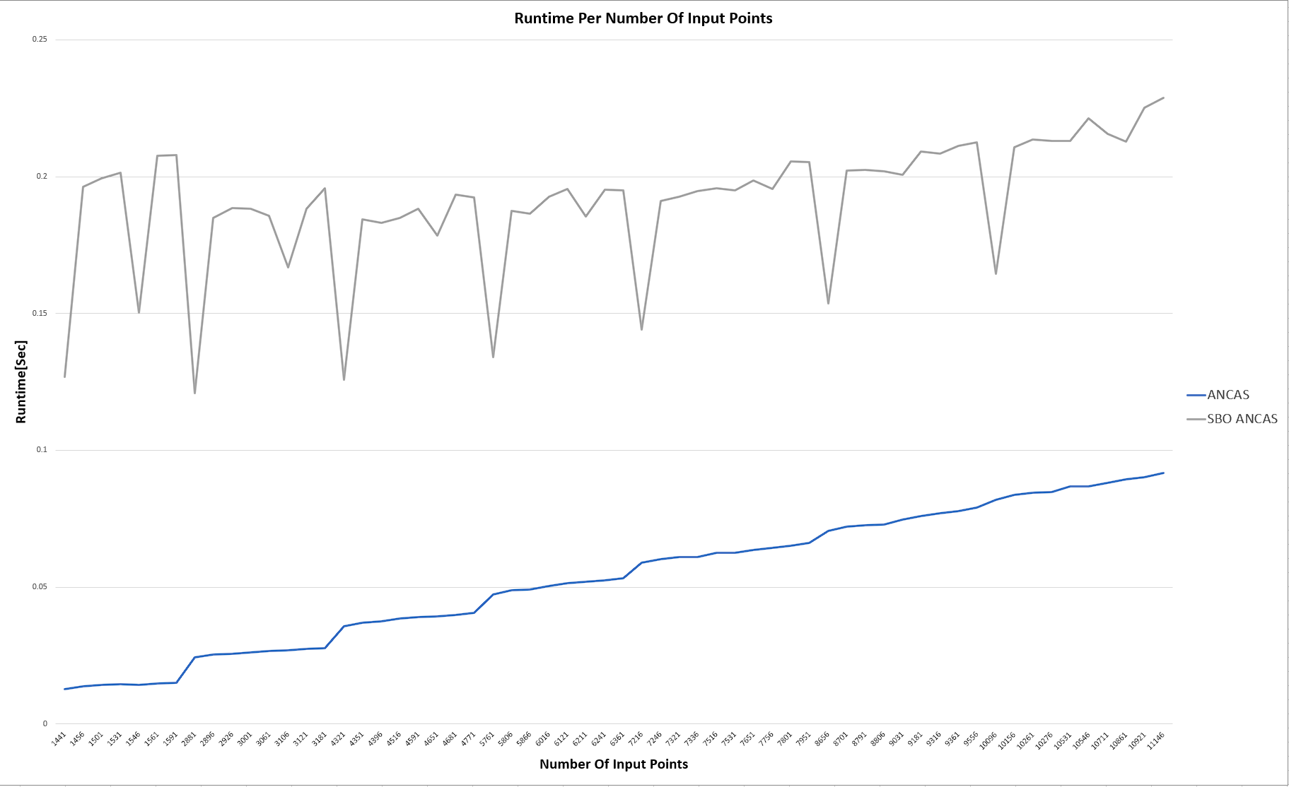
Feasibility testing – correlations
Constant time interval- changing number of points
Notes:
תיאור הפתרון

Slide 19
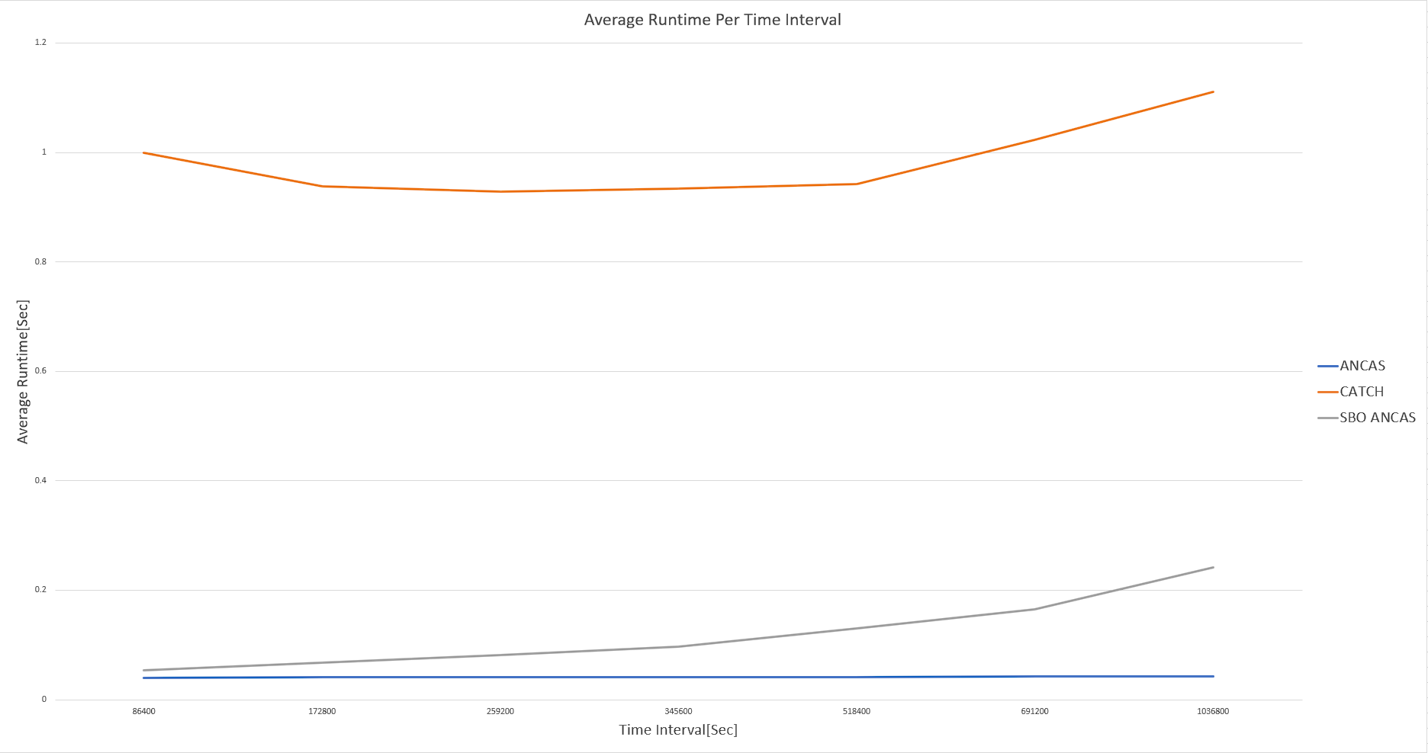
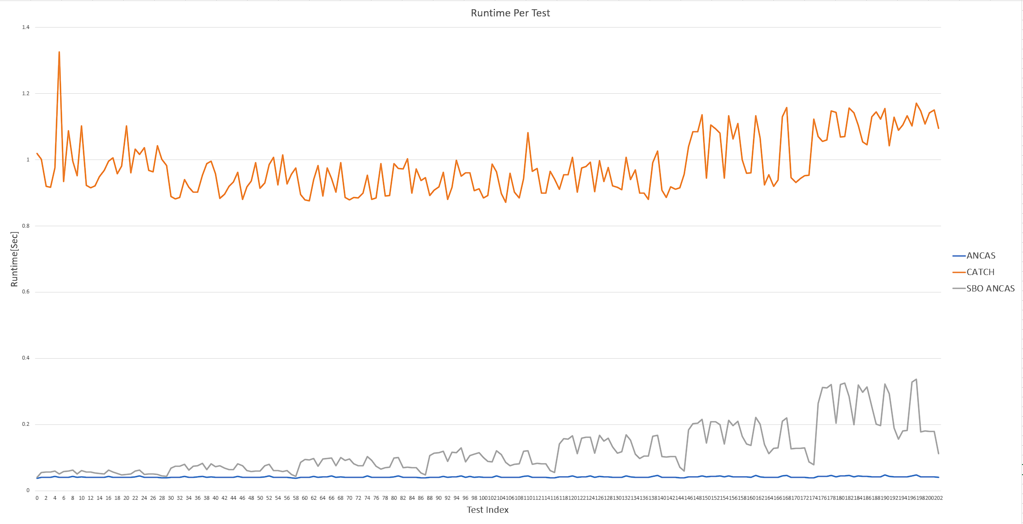
Feasibility testing – correlations
Constant number of points – changing time interval
Notes:
תיאור הפתרון

Slide 20
Challenges
Developing for unknown / multiple systems
Testing and debugging
Notes:
תיאור אתגרים ובעיות

Slide 21
Bibliography

